Slide 1

Car Accident Severity
Monika Singhal

Slide 2
About Data
Detailed road safety data about the circumstances of personal injury road accidents in UK in 2018, published by central government of UK
Relates only to personal injury accidents on public roads that are reported to the police
Contains 157342 rows and 47 columns
https://data.gov.uk/dataset/cb7ae6f0-4be6-4935-9277-47e5ce24a11f/road-safety-data

Slide 3
Business Problem
Accidents in traffic lead to associated fatalities and economic losses every year and thus is an area of primary concern to society from loss prevention point of view
Modeling accident severity prediction and improving the model are critical to the effective performance of road traffic systems for improved safety
Predicting the probability and severity of vehicular accidents based on weather and other characteristics, can help in improving the traffic accident management process
Accident severity prediction can provide crucial information for emergency responders to evaluate the severity level of accidents, estimate the potential impacts, and implement efficient accident management procedure

Slide 4
Data Cleaning
In total, 157342 rows and 47 columns in the raw dataset
Duplicate features were dropped
Cleaned data contains 42 features
Removed highly correlated variable
Combined two classes (Serious and Fatal) into one (Serious) due to presence of significant imbalance and to simplify classification (New Target Dummy)
Applied different types of resampling to avoid highly unbalanced data problem

Slide 5
Preliminary EDA showed
Presence of TARGET Variable imbalance problem
TARGET Variable highly correlates with ‘Casualty_Severity’ variable
Visualisation: high impact of some FEATURES: Urban_vs_Rural Area, Road_Surface_Conditions, Age_Band, Sex, Speed limits, Weather Conditions

Slide 6
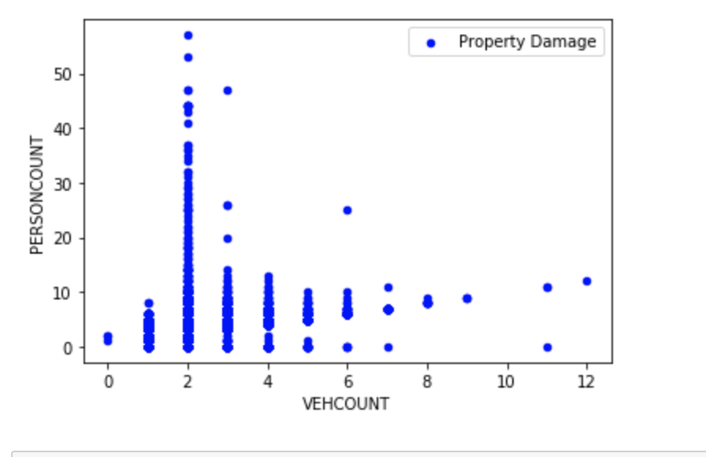
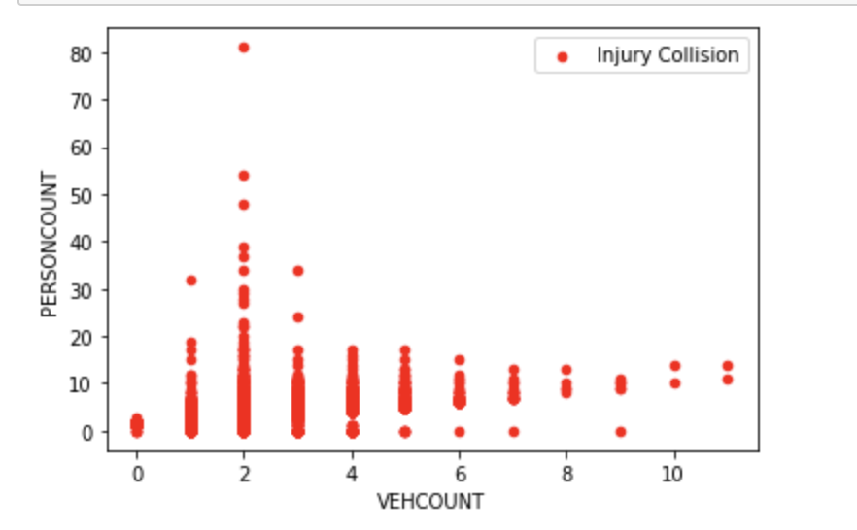
Vehcount = 2, get the highest property damage

Slide 7
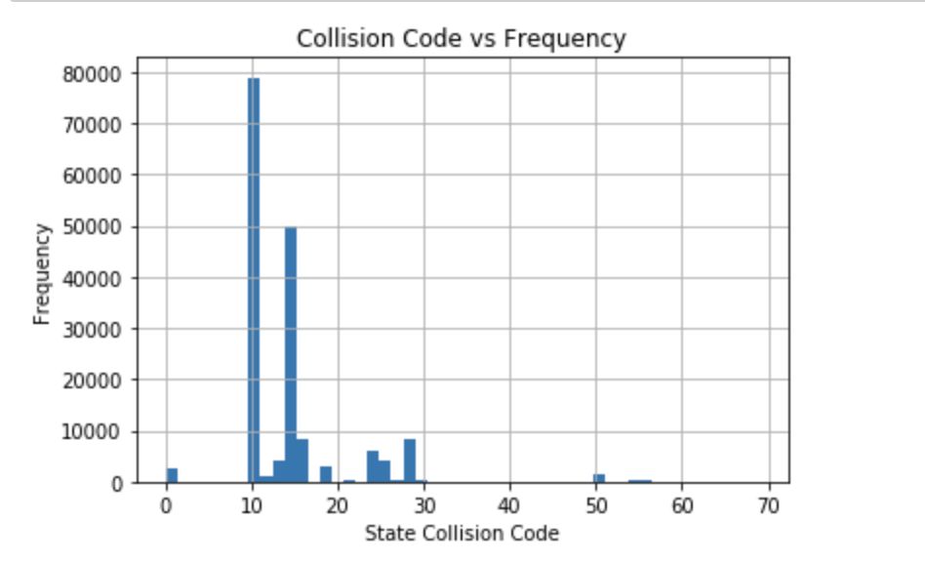
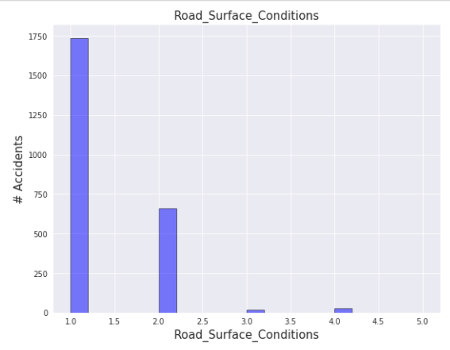
More accidents occur in dry roads

Slide 8
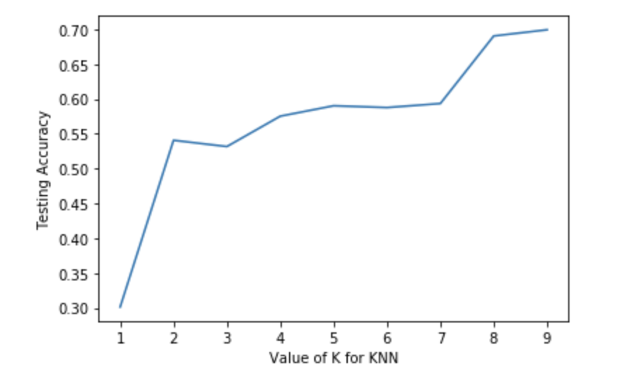
KNN Model when k = 9 gets the highest accuracy

Slide 9
Conclusions
We can predict severity of accident with 78% accuracy.
Factors that contribute:
Male drivers dominate in serious accidents (>70%);
People in 19-35 age range, considered as a risk group;
Fatal car accidents happen 2.4 times more in Rural area than in Urban;
Majority of accidents occur in good weather conditions;
Fatal car accidents tend to happen on roads with higher speed limits.

